Slide 1


Pothole Detection System Analysis

Slide 2
ABSTRACT

Slide 3

Roads play an important part in day-to-day transportation for every person around the world. But the quality of roads decreases drastically due to the way of usage and ageing resulting in deterioration of the road surface.
Potholes are a nuisance , especially in developing countries , and can often result in vehicle damage or physical harm to the vehicle occupants.
We aim to harness modern technologies to create products that are feasible, robust, flexible, and modular. Utilizing emerging technologies, we have conducted a comparative study of machine learning models for pothole detection.

Slide 4
The data for this study was gathered using multiple Android devices across various routes and vehicles and was preprocessed with a 2-second non-overlapping moving window to extract relevant statistical features for training a binary classifier.
We have also used a dataset from Kaggle. The Test dataset was isolated entirely from the Training and Validation datasets, and a stratified K-fold cross-validation was applied to the Training dataset.
We will perform different models like Random Forest Tree which is a supervised learning and YOLO which is a unsupervised learning on the dataset and analyze which shows the best performance by looking at the accuracy.

Slide 5
Data set Description

Slide 6
The dataset has both the normal and pothole images.
Case 1: Here normal images are 367 images and pothole images are 357.
Case 2: Here normal images are 339 images and pothole images are 929.
Case 3: Here normal images are 351 images and pothole images are 329.
Case 4: Here normal images are 706 images and pothole images are 1286.
Case 5: Here normal images are 718 images and pothole images are 686.
https://www.kaggle.com/datasets/atulyakumar98/pothole-detection-dataset
https://www.kaggle.com/datasets/virenbr11/pothole-and-plain-rode-images

Slide 7
Model

Slide 8
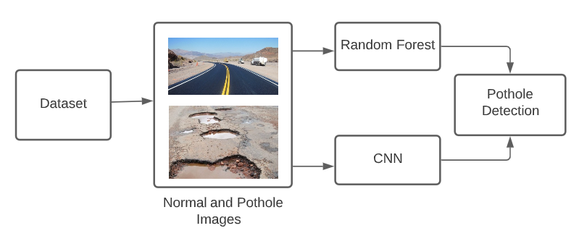

Slide 9
Working Model of Random Forest

Slide 10

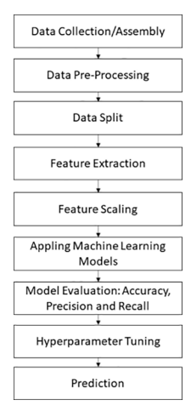




Slide 11
Working Model of CNN

Slide 12
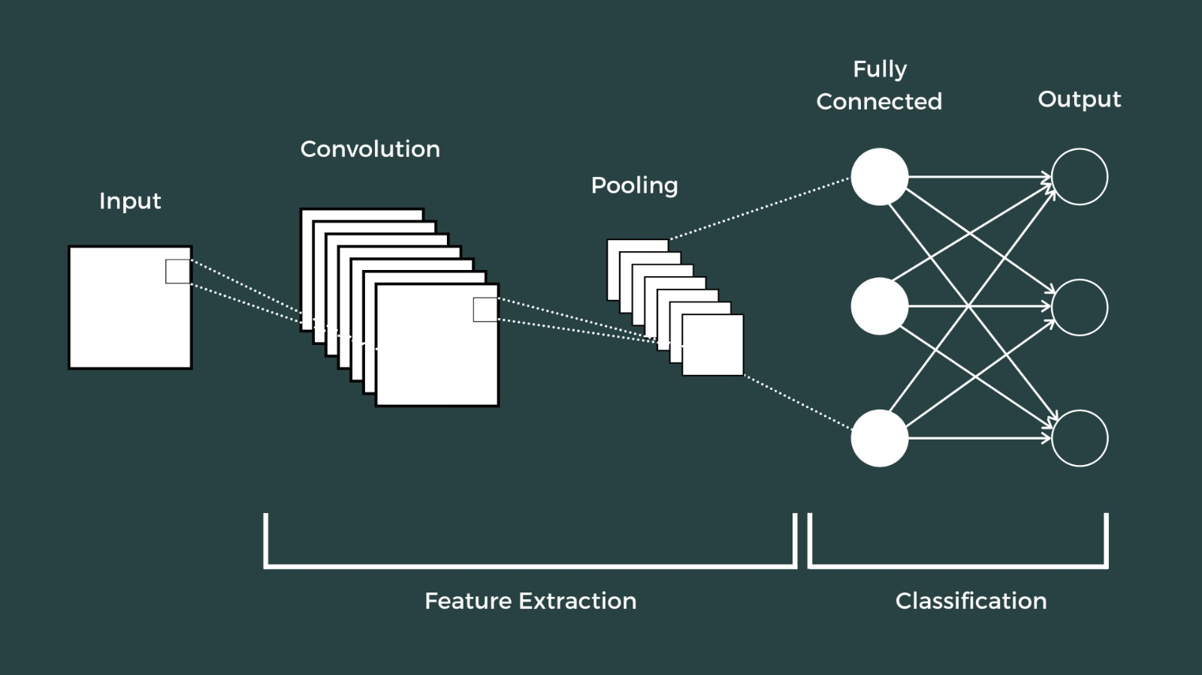

Slide 13
Pros & Cons

Slide 14
Pros : We can automate the identification of potholes and reduce the accidents on the road also car damages can be decreased.
Cons: Accuracy may not be 100 percent.
Future scope: This system can be implemented on a real time dashboard camera. . The system can also be activated with a GPS module that will mark the coordinates once the pothole has been detected by the dashboard module. The coordinates can then be used to identify the potholes by maintenance workers who then work on the damaged road.

Slide 15
Research Questions

Slide 16

1. How can machine learning and deep learning models be used to detect potholes in road surfaces?
Machine learning and deep learning models can be employed to detect potholes by analyzing data collected from various devices installed in cars traveling on different routes. By applying statistical feature extraction to the collected data, which is preprocessed using a 2-second non-overlapping moving window, these models can learn to identify patterns that signify the presence of potholes. Supervised learning techniques can then be applied to train these models to recognize and classify pothole-related anomalies accurately.
2 . Can deep learning models like Convolutional Neural Networks (CNNs) outperform traditional machine learning algorithms for pothole detection?
Convolutional Neural Networks (CNNs) are particularly well-suited for image data analysis and may outperform traditional machine learning models in detecting potholes due to their ability to capture spatial hierarchies in images. CNNs can automatically detect edges, textures, and other relevant features in road surface images without the need for manual feature engineering, potentially leading to more accurate and reliable pothole detection.

Slide 17
3. How can supervised learning algorithms be used to detect potholes in images?
Supervised learning algorithms require a labeled dataset, where images of road surfaces are tagged as 'pothole' or 'no pothole'. These algorithms learn from this labeled data to develop a model that can predict the labels for new, unseen images. By training models on diverse road conditions and pothole variations, the algorithms can generalize better and detect potholes with higher accuracy.
4. Can we use unsupervised learning algorithms to detect the presence of potholes in road images?
Unsupervised learning algorithms can be used to detect potholes by identifying unusual patterns or outliers in road surface images. These algorithms analyze data without prior labeling, discovering inherent structures and anomalies in the images. Techniques such as clustering can segregate pothole features from normal road features, facilitating the detection of irregularities that might indicate potholes.

Slide 18
Evaluation Metrics

Slide 19
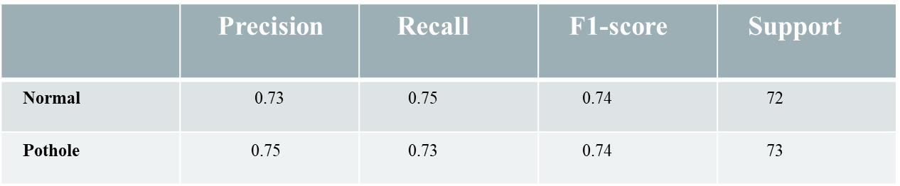
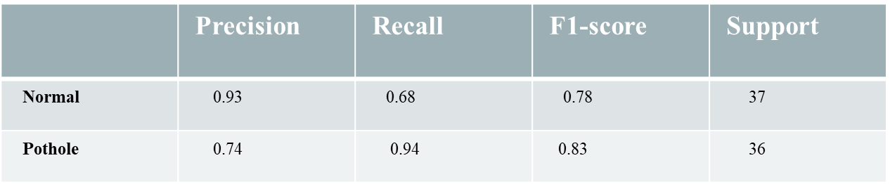
Framework: Random Forest
Framework: CNN

Slide 20
Analysis

Slide 21

Based on the performance analysis of both random forest and CNN models, it is evident that CNN yielded superior results compared to random forest. This indicates that the deep learning model CNN outperformed the machine learning model random forest. However, it's important to note that these observations were made considering the small datasets used. It is possible that if the dataset size is increased, random forest might yield better results. As of now, based on the available information, CNN has been shown to be the better performing model.

Slide 22
Results

Slide 23
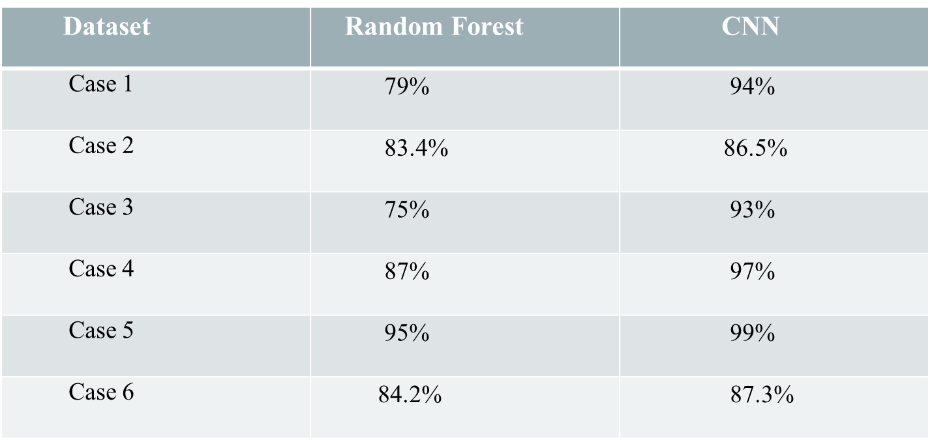

Slide 24
Conclusion

Slide 25
We've developed a machine learning system capable of detecting potholes with high precision, using data from mobile devices.
The Random Forest model, after hyperparameter tuning, emerged as the most effective, suggesting it's highly suitable for real-time pothole detection.
Our findings point to the potential for widespread adoption, improving road safety and maintenance efficiency.

